Slide 1

Clinical-Trial Survival Analysis for Treatment Efficacy
Understanding Time-to-Event Data in Medical Research.

Slide 2

Why This Project Matters
Critical Insights
Clinical trials are fundamental for new treatments.
Unique Challenges
Censored data and patient dropout are common issues.
Essential Tool
Survival analysis directly addresses these complexities.

Slide 3
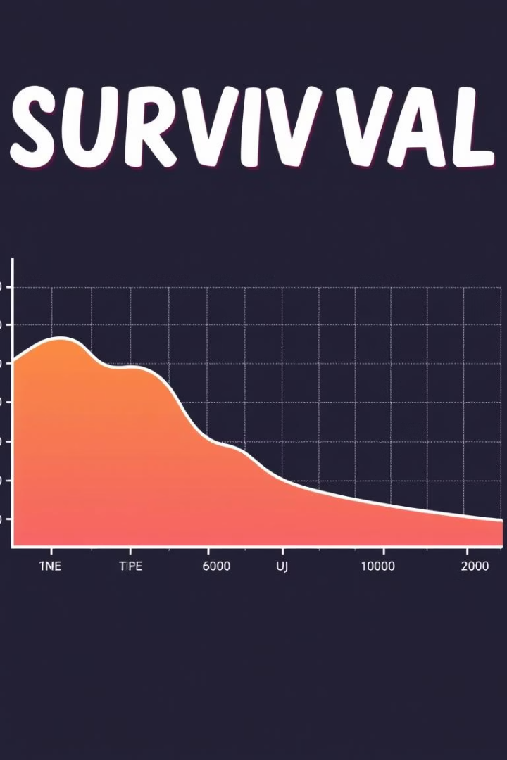



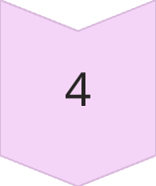
Project Goals
Analyze Time-to-Event Data
Understand durations until specific events occur.
Visualize with Curves
Create insightful survival probability plots.
Perform Statistical Tests
Validate hypotheses about group differences.
Handle Real-World Data
Address complex data characteristics effectively.

Slide 4
Key Models Overview
Kaplan–Meier Curve
Cox Proportional Hazards
Stratified Cox Model
Non-parametric estimation of survival probabilities.
Assesses covariate impact on hazard rates.
Handles non-proportional hazards for strata.
Log-Rank Test
Time-Varying Covariate Model
Competing Risks Model
Compares survival curves between groups.
Accounts for covariates changing over time.
Analyzes multiple possible endpoints.

Slide 5

Installing and Importing Libraries
lifelines
pandas
Core library for survival analysis models.
Data manipulation and analysis toolkit.
matplotlib
Static, interactive, and animated visualizations.

Slide 6

Loading the Data
We use the veteran.csv dataset for demonstration.
df.info()
df.head()
Summarize DataFrame information and data types.
pd.read_csv()
View the first few rows for initial inspection.
Load the dataset into a DataFrame.

Slide 7
Model Implementation
Kaplan–Meier Estimator
1
Estimate survival probabilities over time. Plot the survival curve.
2
Log-Rank Test
Compare survival distributions between groups. Obtain p-values.
CoxPH Model
3
Fit proportional hazards regression. Interpret hazard ratios.
4
Time-Varying Covariates
Handle covariates that change during follow-up. Adjust model dynamic effects.
Stratified Cox
5
Account for varying baseline hazards. Model different strata.
6
Competing Risks
Analyze multiple event types. Estimate cumulative incidence functions.

Slide 8




Real-World Impact
Pharma
Accelerate drug development and approval.
Hospitals
Improve patient care and treatment protocols.
Public Health
Inform policy and disease management strategies.

Slide 9
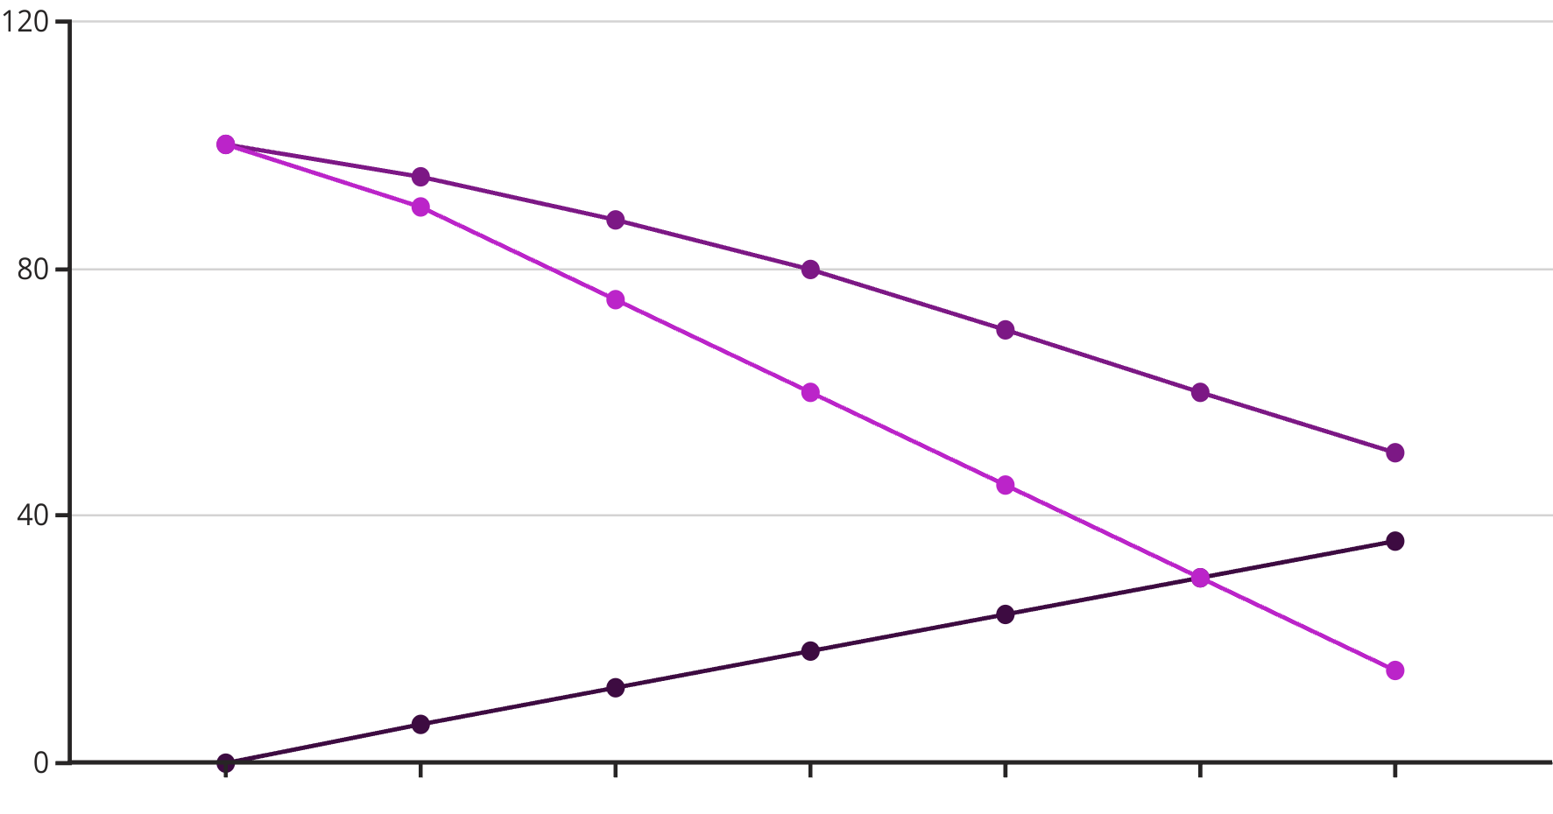
Visualizing Survival with Kaplan-Meier Plots
Kaplan-Meier plots visually represent survival probabilities over time. They effectively illustrate how survival rates change for different patient groups. This visualization is crucial for comparing treatment efficacy.
Time (Months)
Treatment Group A Survival ...
Treatment Group B Survival ...

Slide 10
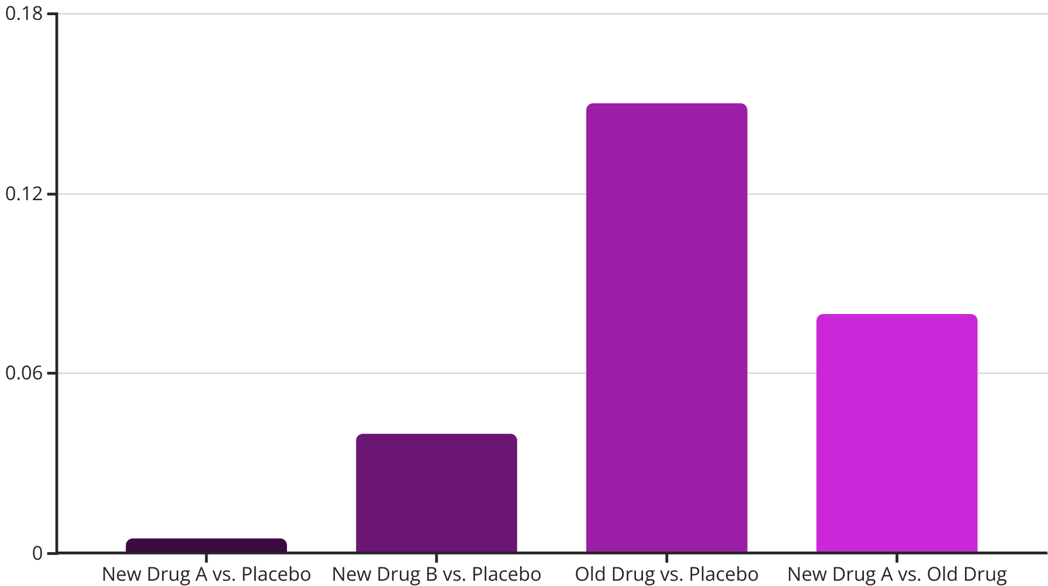
Analyzing Survival Differences with Log-Rank Plots
The Log-Rank Test compares survival curves across different groups. It assesses whether observed differences are statistically significant. This helps determine which treatments show a greater impact on patient survival outcomes.
This chart illustrates hypothetical p-values from log-rank tests. Lower p-values, like 0.005, indicate stronger evidence of a significant difference in survival between groups. This guides clinical decision-making.

Slide 11




Survival Analysis Technologies
Data Pipelines
Modeling Engines
Interactive Visuals
Cloud Platforms
Tools for robust data ingestion and preprocessing workflows.
Specialized libraries for advanced statistical survival models.
Dynamic dashboards for exploring complex survival patterns.
Scalable infrastructure for large-scale clinical dataset analysis.

Slide 12

Understanding Statistical Significance
1
P-Value Meaning
2
Significance Threshold
P-values quantify evidence against the null hypothesis. Lower values indicate stronger, non-random effects.
A common threshold is 0.05. Results below this are considered statistically significant, guiding decisions.
3
Clinical Validation
Significance confirms treatment efficacy. It distinguishes real effects from chance in survival outcomes.

Slide 13

Empowering Future Discoveries
Survival analysis provides critical insights for treatment efficacy and patient outcomes. Advanced models and robust technologies accelerate medical breakthroughs. This empowers informed clinical decisions and improves public health.

Slide 14
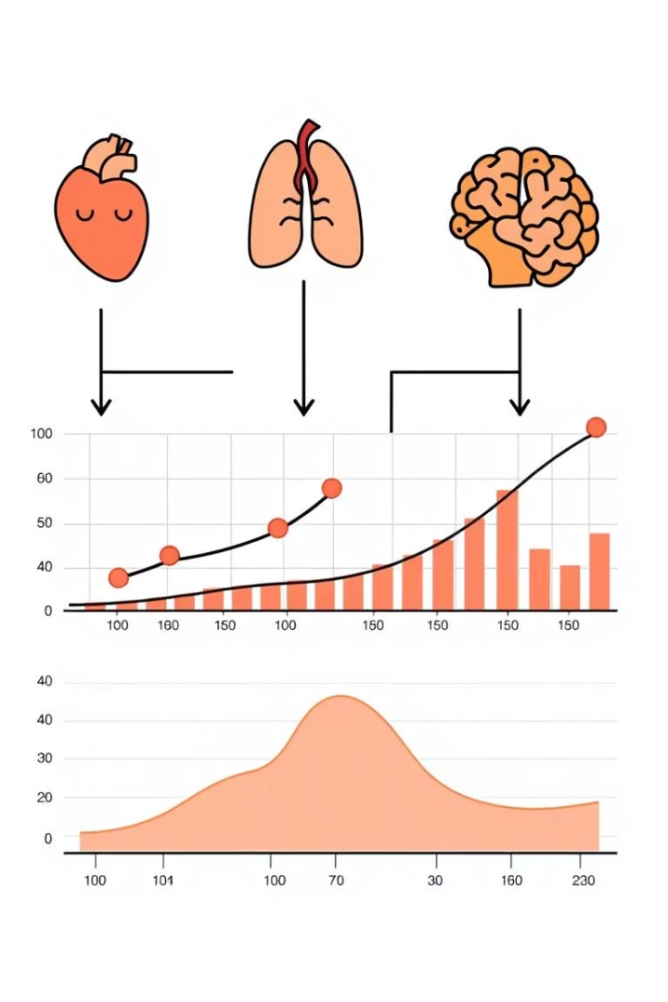
Cox Proportional Hazards
This statistical model examines how various clinical factors influence patient survival outcomes. It quantifies the impact of different covariates on the hazard rate over time.
Cox models are essential for identifying significant risk factors and predicting patient prognosis. They are widely applied in clinical trials for robust treatment efficacy analysis.

Slide 15



Hazard Ratio
Ratio of Hazards
Compares the instantaneous risk of an event, like death, between two patient groups.
Interpreting Values
HR=1 indicates no difference. HR<1 means lower risk; HR>1, higher risk.
Treatment Comparison
Essential for evaluating treatment efficacy in clinical trials and predicting patient outcomes.

